Slide 1
The Implementation and Application of Multiclass Belief Propagation on Hadoop
Guanyu Wang
Yuchen Tian
Yu Su
Huanchen Zhang
Institute for Software Research
Carnegie Mellon UNIVERSITY

Slide 2
Introduction
Belief propagation, is an popular algorithm for inference on graphical models. It calculates the marginal distribution for each unobserved node based on observed ones.
Fast Belief propagation , first proposed by Koutra, et al. is a proximation of Belief propagation of two classes under the “about-half” assumption. FastBP converges much faster than the general BP by stepping aside the message passing process.

Slide 3
Contributions
Improve Multiclass BP on Hadoop
Convergence Detection; Massage Smoothing.
Extend FastBP to Multi-class Problem
Theoretical derivation
Error Correcting Code Approach.
Apply BP and FastBP in mutliclass large graphs.
Tencent Weibo Following Network
Flickr Sharing Datasets
DBLP Network
Amazon Co-Purchasing Network.

Slide 4
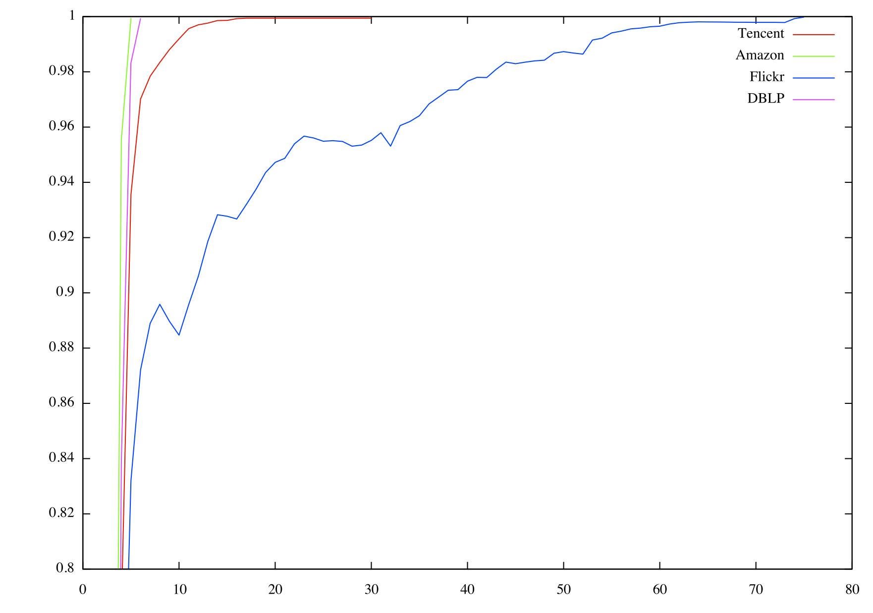
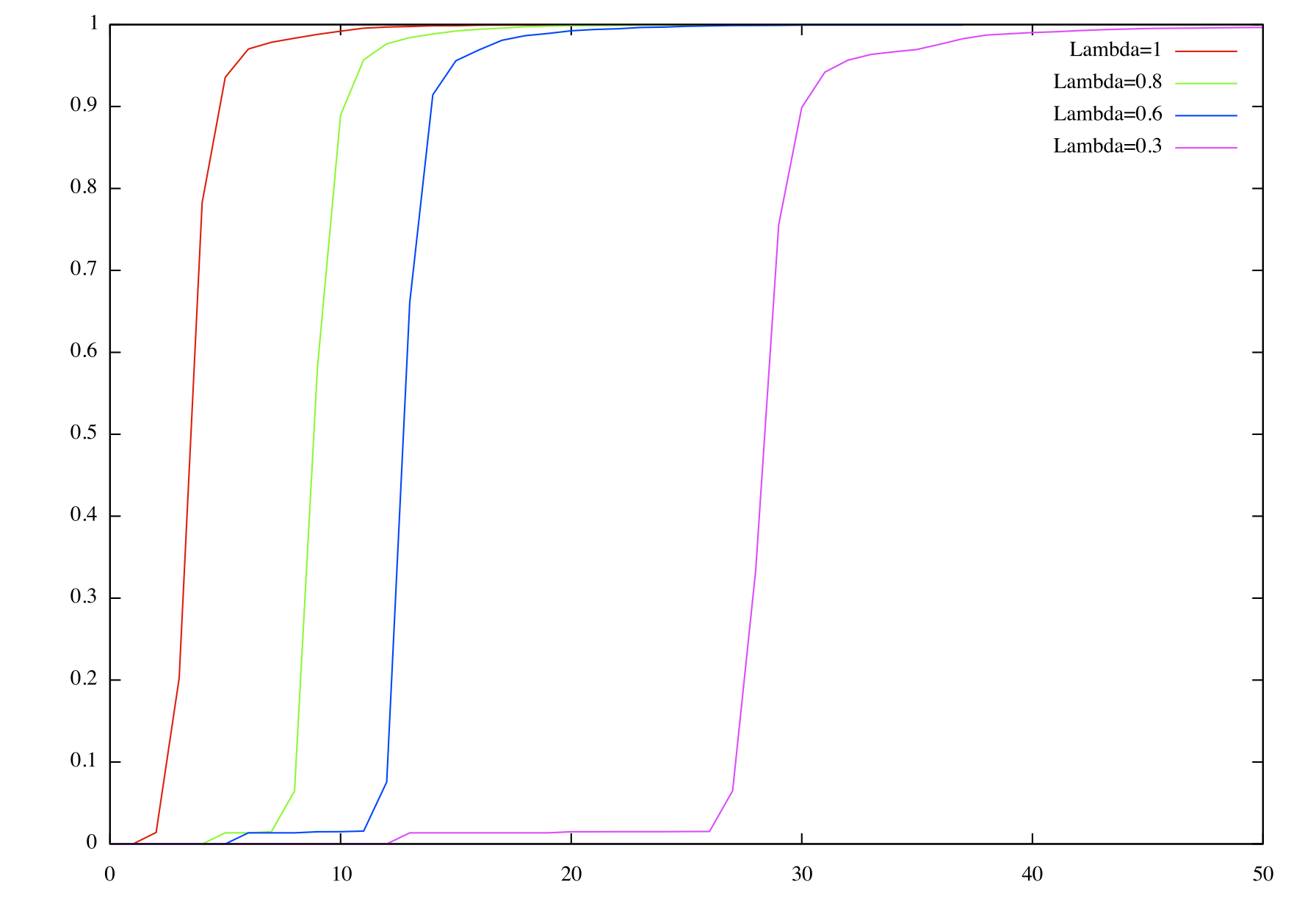
Improvements on BP
Converge Detection
Avg. |new_msg - old_msg| < ε
Message Smoothing
Smoothed msg = λ * new_msg + (1 - λ) * old_msg

Slide 5
Theoretical derivation
Brief Introduction:
Use the assumption that correlation matrix is close to an identity matrix
Use the slack variables to relax the relation between any nodes and its sending and received message.
Use KKT conditions for formulated optimization problem to derive a equation system, which provides the final approximation of BP.
Use quadratic approximation instead of Maclaurin approximation to remove the “about-half” assumption.

Slide 6
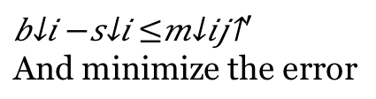







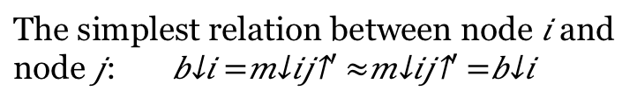
Theoretical derivation
$b_{i}=diag\left(m_{ji}\right)Ψ^{−1}m_{ij}={m_{}^{′}}_{ij}$
j
Symmetry
$$b_{j}=diag\left(m_{ij}\right)Ψ^{−1}m_{ji}={m_{}^{′}}_{ji}$$
$$b_{j}$$
$$m_{ji}$$
Assume $Ψ≈I$
$$m_{ij}$$
The simplest relation between node $i$ and
node $j$: $b_{i}=m_{ij}^{′}≈m_{ij}^{′}=b_{i}$
$$b_{i}$$
i
Add slack variable
$$b_{i}−s_{i}≤m_{ij}^{′}$$
And minimize the error

Slide 7
Error Correcting Code
Introduction:
Given k-classes, for each class, design a N-bit zero-one code.
For a given example, run the binary classifier N times for each bit position to calculate the probability that value of that bit is one.
Combine the N results, decide the final label.
Hamming distance
Loss function based.
The popular One-VS-All method is a special case of ECOC families.

Slide 8
Experiments
Results on datasets.
Analysis
One-VS-All has the best average accuracy.
Multiclass BP tends to give every node the same label, not as reliable as One-VS-All and ECOC approach.
ECOC performs slightly worse than One-VS-all in experiments.
Dataset | MBP | One-VS-All | ECOC
DBLP | 0.17 | 0.776 | 0.726
Flickr | 0.653 | 0.421 | 0.13
Tencent | 0.953 | 0.961 | 0.924
Amazon | 0.736 | 0.636 | 0.626

Slide 9
Conclusion
We implemented Convergence Detection and Message Smoothing.
We designed and run one-vs-all and ECOC to extend FastBP to mul-ticlass.
BP on multi-class can be approximated efficient with good accuracy when the correlation matrix is close to an identity matrix.
Experiment

